Slide 1
Jerusalem Symphonic Poem for the Palestinian Musician Yusuf Khasho and the Double Standards Treatment in the Italian philharmonic

Slide 2
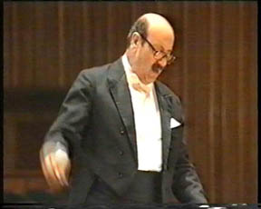
Yusuf Khasho
A Palestinian Composer
Prepared By:
Khalifa Mohammad Mahmoud Jadallah
Department of Music Science
Faculty of Fine Arts
An-Najah National University/ Palestine

Slide 3
Yusuf Khasho
Introduction:
It is not always obligatory for geniality signs to be manifested early in one’s life. However this was the case for great music beacons like Mozart, Beethoven and also Yusuf Khasho.
It is perhaps ironic that at the age of 5 this great musician became an orphan and found a refuge in the orphanage belonging to the Franciscan Fathers in Jerusalem. There could not have been a more congenial place for the extraordinary talents to be manifested, exposed and eventually cultivated. It is perhaps prudent to mention that this religious order known as the Order of Friars Minor played and still plays a major role in helping the Palestinian steadfastness and in protecting the most important historical and religious sites in Palestine from expropriation. They justifiably hold the privileged title of the Custodians of the Holy Land.
Furthermore, the Palestinian Nakba (catastrophe) had a profound influence on young Yusuf; in retrospect, it impacted and thus shaped his life beyond expectation.

Slide 4
Khasho’s Life:
Yusuf Khasho was born to an ordinary Christian family in Jerusalem on the 24th of May 1927; he witnessed very difficult first years of his life as Palestine was then being systematically colonized by Zionist organizations. Life was insecure, the economy was unstable, and living in old Jerusalem was a struggle in itself. When Yusuf was five years old, his father passed away, and he was raised in the orphanage of a monastery belonging to the Order of Friars Minor, known also as the Franciscan Convent situated at the New gate of the Old City of Jerusalem. At age 13, he was called upon to play the organ at church and conducted the choir when Maestro Lama was not able to attend. In 1948, he was appointed music teacher at Terra Sancta High School in Jerusalem.
In 1936, when Palestinian composer and music teacher, Augustine Lama, listened to the nine-year-old Yusuf Khasho, he uttered almost the same words that were pronounced 220 years earlier by Mozart when he was asked to teach music to a young boy who grew up to become Ludwig van Beethoven. That young boy, Yusuf Khasho, became a leading symphonic composer not only in Palestine, but also in the entire Arab world.

Slide 5
During the 1950s, a few years after the Palestinian tragedy of 1948, he went to Jordan and then to Syria. His music skills and abilities started to grow from Middle Eastern to western, from light music to drama, and even to jazz and blues. As many other thinkers, artists, musicians, and writers, he settled for a time in Beirut, where he continued to develop his musical skills and knowledge.
In the sixties, when Yusuf was in Aleppo, he decided to specialize in orchestral music composition and conducting. Classical music was new to Aleppo, yet its rich oriental music was a popular form of culture. Khasho quickly integrated into the music scene and left his own legacy: he helped organize an oriental ensemble and worked to reform the music school. Afterwards he went to Rome to enroll in advanced studies in classical music. It was during this period that the ‘Jerusalem Symphony’ came to life.

Slide 6
Khasho’s Music Career:
As a true Arab citizen who realized the plight of his nation after the loss of Palestine, Yusuf was very much a nationalist at heart. His love for his country and Jerusalem, the city of his birth, was an omnipotent beacon throughout his life. Perhaps his most famous symphony, albeit not the richest in composition, was ‘The Jerusalem Symphony’.
After the war which broke out in Palestine on the 5th June 1967, the Catholic Church in Amman gave shelter to some Arab refugees. One Sunday, towards the end of June the same year, the composer assisted at Mass in that church and was impressed by the fact that the Muslim refugees joined with the Christians in prayers, repeating in the low voice "Allah Akbar " (God is above all).

Slide 7
The sight of Muslims and Christians thus praying together brought vividly to the author’s mind of memory of his native town, the Holy City of Jerusalem, which, so often, over the centuries, has been subjected to terror and drenched in blood, while its inhabitants were driven way into exile.
“ The Jerusalem Symphony”, a copy of which is attached, evokes the story of the Palestinian refugees, who, looking across the river Jordan towards their mother-land, recall the events of the last twenty years and the homes they left behind, with the same feelings in their hearts as other unhappy Palestinians refugees had, some 2500 years ago, and of which we can grasp the anguish in Psalm 136: “ by the rivers of Babylon, there we sat and wept remembering Zion; on the poplars that grew nearly we hung up our harps, if I forgot you, Jerusalem, let my right hand wither, let my tongue cleave to my mouth, if I remember you not and If I prize you not, O Jerusalem, above all my joys”. The Jerusalem Symphony is musically comprised of four movements. They are as follows:

Slide 8
1.First movement:
The symphony opens with the Gregorian theme of “Kyrie Elision” (Lord have mercy) and of “Allah Akbar” (God is above all) and thus underlines the religious character of Jerusalem and its importance as the centre of the three monotheistic religions: Judaism, Christianity and Islam.
An Allegro passage involving flutes, oboes, clarinets and bassoons, represents a peaceful Jerusalem with hits typically oriental in character. The secondary themes bring out the nature and the beliefs of the different Religions whose pilgrims visit the Holy City on perpetual basis.
The early struggles of the Palestinian Arabs at the end of World War II to achieve full independence is symbolized by the sound of trumpets, while in the background the strings render Christmas Carols, which suggest the yearning of all for Peace and Justice. The tense situation which arose in November 1947 with the creation of State of Israel is expressed by rhythm on the timpani followed by the shrilling of the trumpets. The savage entry of horns, trombones and drums evokes the memory of the cruel incidents of April 1948, at Deir Yassin. The first movement ends with the Israeli victory which deprived the Palestinian Arabs of a good many of their towns and villages.

Slide 9
2. Second movement:
This is an Adagio movement and the sad melody recalls the drama, the suspense, the shock and the grief in the hearts of the refugees, especially among the widows and orphans, who lost their husbands and fathers as a result of war. Many refugees found temporary homes in camps in neighbouring countries and in the remaining Arab part of Palestine. Here Christians and the Moslems joined in common prayer and a sacred music to the theme of “Ubi caritas” and the polyphonic structure of “Allah Akbar”.
There follows a Grandioso passage showing the Moslem and Christians refugees, all believers in the One True God, expressing their faith in Him, the Almighty One, and praising His greatness and His glory . It is a reminder to all who believe in Almighty God of their duty to do all in their power to find a just and equitable solution which will put an end to the abundance of misery and suffering.

Slide 10
3. Third Movement:
The Presto passage in 6/8 tempo recalls how for 19 years the inhabitants of Jerusalem, with deep faith in God, united their efforts to rebuild and beautify the Holy City, making it again a Haven of Peace and a centre of pilgrimage where the faithful from all over the world could freely approach their own Holy Places. The third movement is fast and uses his own themes to represent the fall of Jerusalem and the story of war. This is the status of Jerusalem in the period of 1948 and 1967.

Slide 11
4. Fourth movement:
June 5th 1967, Jerusalem. The Holy City of Peace was once more turned into a battle field, and blood was again shed along the Via Dolorosa, Christ’s way of the Cross. The first passage is triste or melancholic. Funeral Bells and the prayer of “Allah Akbar” symbolize the rapid burial of the innocent victims of war.
The next passage Allegro and the Finale, which is a flourish of drums, trumpets, trombones and strings, are meant to instill into the hearts of the refugees and the inhabitants of Jerusalem, courage for the present and confidence for a brighter future. The finale is a sad movement in which fast sections often break in to portray the revolt and anger of captured Jerusalem.
In 1966, King Hussein of Jordan invited Khasho to return to Jordan to lead the ‘music renaissance’ movement. He did this with great success and helped found the National Music Conservatory. During this tenure he composed the Urdun, the Great Arab Revolution and the Alhashimiyyeen Symphonies all of which he recorded outside Jordan.

Slide 12
The next stop was Libya, where Khasho was invited by the Libyan Ministry of Culture to lead its music education program. However, in 1972, he moved back to Italy and remained there until 1986. During this period, he founded a music research centre to study the relationship between Middle Eastern and European music, all the while continuing to conduct, compose, and perform.
In this year he was awarded the title “Professor of Music” by the Academia Gentium Pro Face. During the final years of his career, he had become a true musician-refined and cultured. He mastered harmony and orchestration and developed a greater affinity for the larger world, not just his small region of the Middle East. Khasho felt destined to introduce Europe and the rest of the world to the richness of Arab culture in modern music philosophy.
Diligently and conscientiously, Yousef developed a professional career that is difficult to classify. It was neither oriental nor occidental, and he certainly did not belong to modern music schools. Some of his symphony movements reveal his efforts to create structures and harmony that are new, yet which refuse to give in to modern harmony and structure.

Slide 13
At the same time, he never stopped using genuine Arab melodies to produce splendid light classical structures and compositions that even experienced composers would find difficult to create.
In 1989, Khasho returned to Jordan to settle for good. He worked for one year to establish the Jordan Academy of Music and then began to teach at Al-Albeit University. He remained on its academic faculty and continued to compose and perform until he passed away on 8 March 1997. His legacy of compositions includes twelve symphonies (and one that was never completed), many short pieces for piano, voice, and other instruments, and an operetta-style children’s drama. The greatness of Khasho is perhaps his mastery of integrating and incorporating various styles, cultures, harmonies, and structures in a way that brings rich Arab culture and tradition into modern form in terms of classical music. Very few Arab musicians did that. Khasho made about 14 different musical compositions that justifiably gained universal acclaim. Most of his compositions were based on some nationalistic themes mixed with mundane popular melodies.

Slide 14
Conclusion:
Finally, it is a generally agreed upon necessity that the legacy of remarkable individuals should never evade. Other notable Palestinians must be encouraged to follow the path of Yusuf Khasho, not only in music but in other fields of human culture and civilization as well. The fact that the city Jerusalem is being celebrated as the capital of Arab Culture should perhaps be used as a catapult towards rejuvenating the grandiose national heritage of Palestine. The onus rests solely on Music Learning Institutions and Universities.

Slide 15
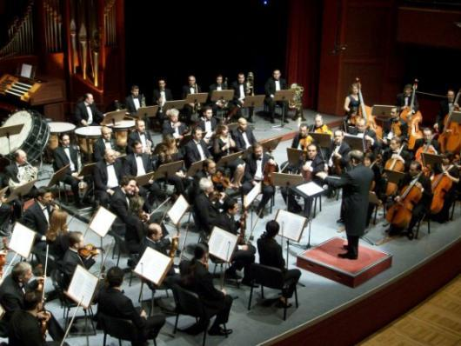
Pictures of the concert

Slide 16
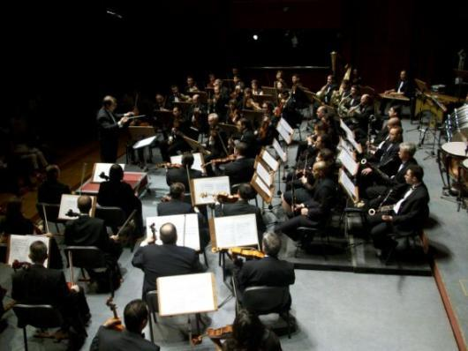

Slide 17
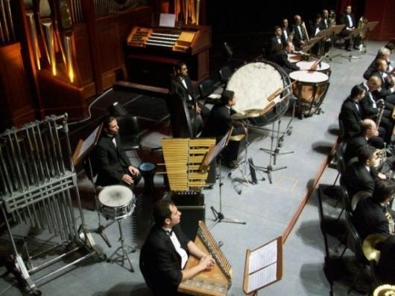

Slide 18
References:
www.alkanani.com/index.php
www.alrai.com/pages.php
www.pal-bam.org/khasho/khasho.htm
www.palestine-family.net/index.php
www.palestine–family.net/index.php
الموسيقا الفلسطينية العالمية. أكاديمية بيت لحم للموسيقا.
موسيقيون من فلسطين. دراسة في الثقافة الموسيقية الفلسطينية العالمية. أكاديمية بيت لحم للموسيقا. سلسلة تاريخ الموسيقا العالمية- 2006/ث-6

